Slide 1
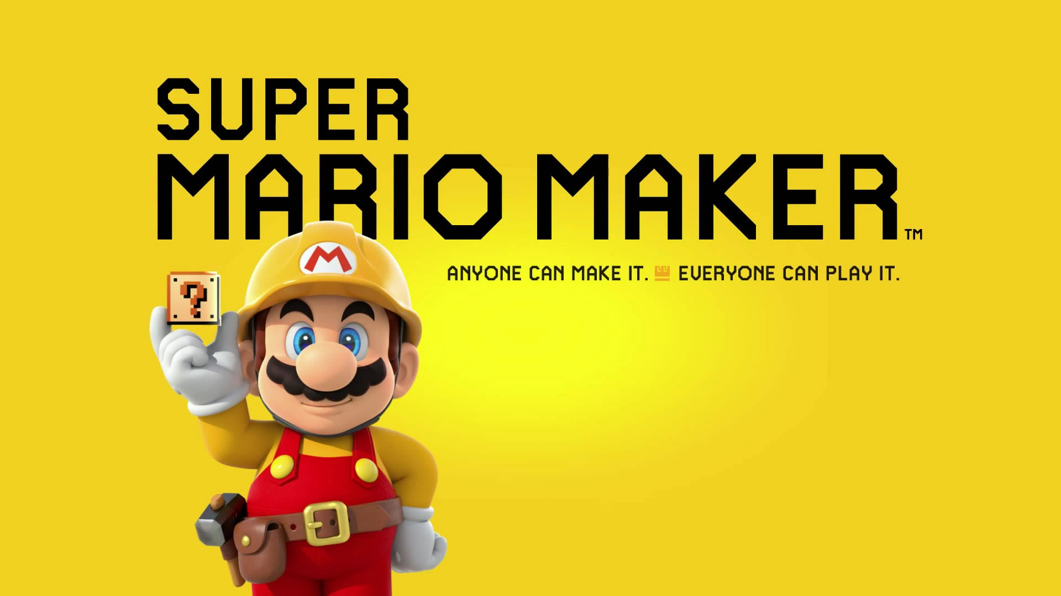

Presented by
Lynelle Chan
Data Analyst
Notes:
Hello everyone and thank you for providing me the opportunity to assist with this milestone for the Super Mario Brothers franchise.

Slide 2


What are the Most Popular Courses in the Super Mario Maker Game?
Notes:
In the year 2025, not only will it be the 40th anniversary of the original Super Mario brothers game, but it will also be the 10-year anniversary for the Super Mario Maker series. In preparation for the development of Super Mario Maker 4, our development team wanted to know: What are the most popular courses in the Super Mario Maker Game?

Slide 3
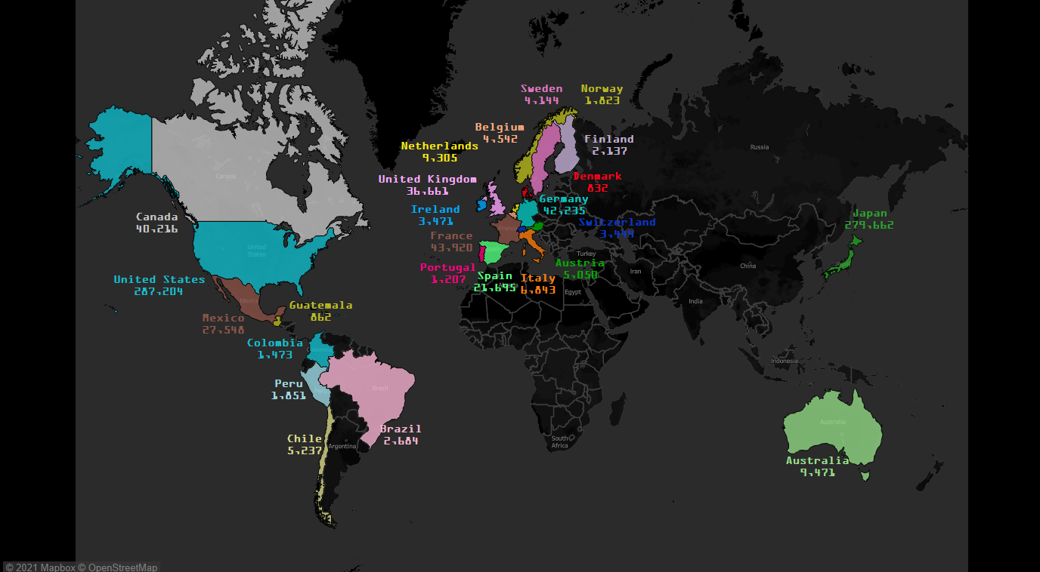

The 25 Countries with the Greatest Number of Players
3.5 Million Units Sold
7.2 Million Levels Uploaded
82 Countries
Notes:
And its no wonder as to why we would want to know this. Super Mario Maker was originally released in 2015 and was instantly a hit with gamers. By May of 2016, the game had sold 3.5 million copies, had over 7 million levels uploaded and was found in 82 countries.

Slide 4

The Data
2017 and 2018 Data
Data Includes
851,824 Players
100,162 courses
3,941,378 recorded plays
3 Areas of Focus
Notes:
The dataset that was provided included data from the last 2 years of the original Super Mario Maker game (which was 2017 and 2018) .
This data included information from about 850,000 players, 100,000 courses, and almost 4 million recorded plays. With over 6 million rows of data to evaluate, tools such as Excel, Python, SQL and Tableau were used to thoroughly analyze the data.
In order to determine which courses were the most popular, the analysis was focused on 3 specific area.

Slide 5

Three Areas of Focus
Most played Level of Difficulty
Criteria Considerations
Organize Results
Notes:
The first area of focus was the most played level of difficulty.
The second area of focus was what criteria should be considered when determining popularity
And finally, how will the results of that criteria be orchestrated to provide the most popular courses overall.
Before we begin the review of the findings, a few of our newer team members are probably wondering…

Slide 6
What is Super Mario Maker?
Notes:
What is Super Mario Maker?

Slide 7
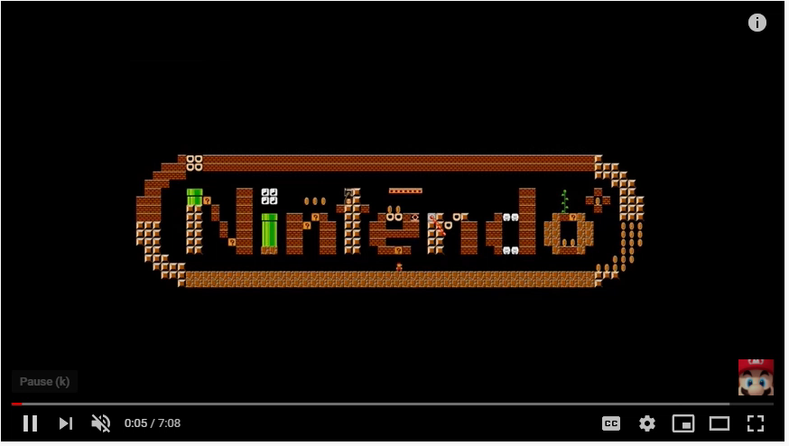
2D Level Creation Game
Players design courses
Share Courses Online
https://www.youtube.com/watch?v=_9W_y8IlNro
Notes:
It is a 2 dimensional creation game that incorporates map styles from Super Mario Brothers, Super Mario Brothers 3, Super Mario World, and New Super Mario Bros U.
Players are able to design their own courses by using various objects, items and enemies.
Through Miiverse, players were then able to share their masterpieces online, as well as download and play courses designed by other players.

Slide 8
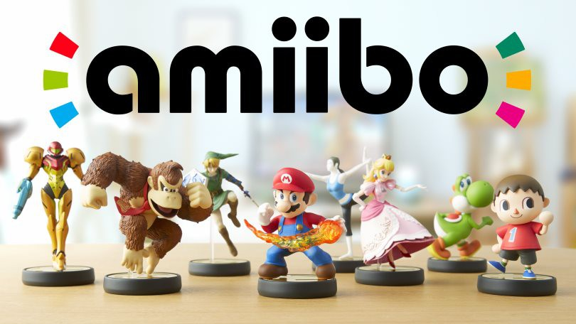

Video Source: https://www.techtimes.com/articles/82732/20150907/amiibo-costumes-super-mario-maker-revealed.htm
Amiibo is a wireless communications and storage protocol that can transform Mario into an 8-bit version of the character.
Notes:
Another unique feature of the game is its compatibility with the popular Amiibo figures. Once connected to the game, an 8-bit version of the character is used in place of a Super mushroom and transforms Mario into that character. With 100 characters available, Amiibos are another great way for players to customize their games.

Slide 9








Notes:
Unveiled at the E3 2014 conference, Super Mario Maker was released in September 2015, as part of the 30th Anniversary celebration for the original Super Mario brothers game. Praised for its social elements, the game had received 6 nominations and had won 4 awards.
The first sequel, Super Mario Maker 2, was created for the Nintendo Switch and released in June 2019. Another sequel, Super Mario Maker 3 is set to be released in 2023.

Slide 10
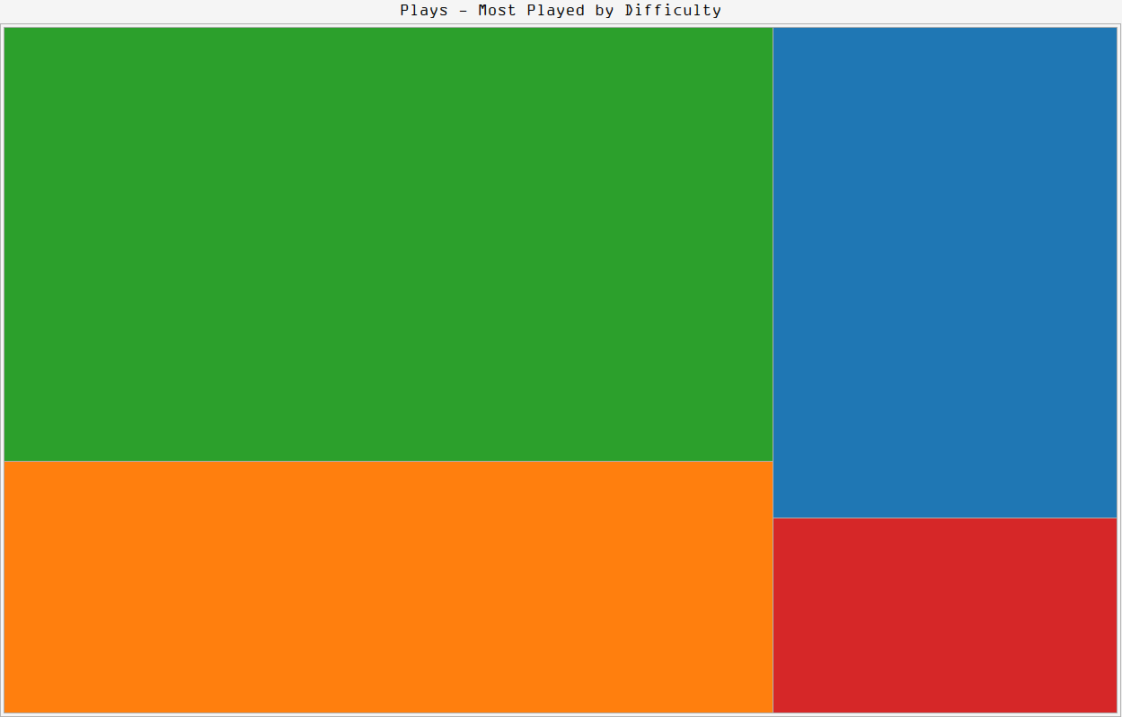
What is the Most Played Level of Difficulty?
Normal
43.8%
Easy
22.1%
Expert
25.3%
Super Expert
8.8%
Notes:
With such a diverse group of gamers, there is a vast variety of player skillset. The game has accounted for this by having 4 levels of difficulty: Easy, Normal, Expert, and Super Expert.
With a request from the development team to know the most frequently occurring difficulty level, I analyzed the total number of plays recorded against the data for difficulty.
In the game, every map can fall within any of the levels of difficulty. The level of difficulty is determined by number of clears and the number of attempts for a specific course. If a course has a lower number of clears (and a greater number of attempts), the level of difficulty rises. During this process, it was determined that the most played level of difficulty was “normal”.
However, due to the dynamic attributes of this data, it is important to emphasize that the results can easily change depending on when the timeframe was recorded. If this particular dataset were provided with different recorded timeframes, I would be able to further analyze how frequently the level of difficulty changes and the affect this has on the overall popularity of specific courses.

Slide 11
Courses
Notes:
Another area of focus for during this analysis has been the courses. As a reminder, this dataset includes over 100k courses. However, it is important know that this is a small sample of the 7 million courses that are created and will only reflect the most popular courses in this set.

Slide 12

What Criteria Should be Used?
Level Tagging
Longest Running Map
Number of Attempts
Number of Stars (AKA Likes)
Number of Tweets
Number of Plays
Clear Rate
Number of Top Records
Number of Clears
Notes:
As you can imagine, there are numerous ways to determine what was the top courses and some of them are listed in this slide.

Slide 13
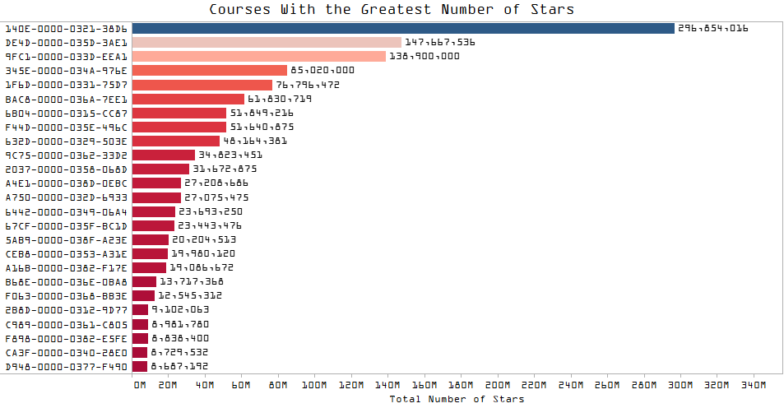
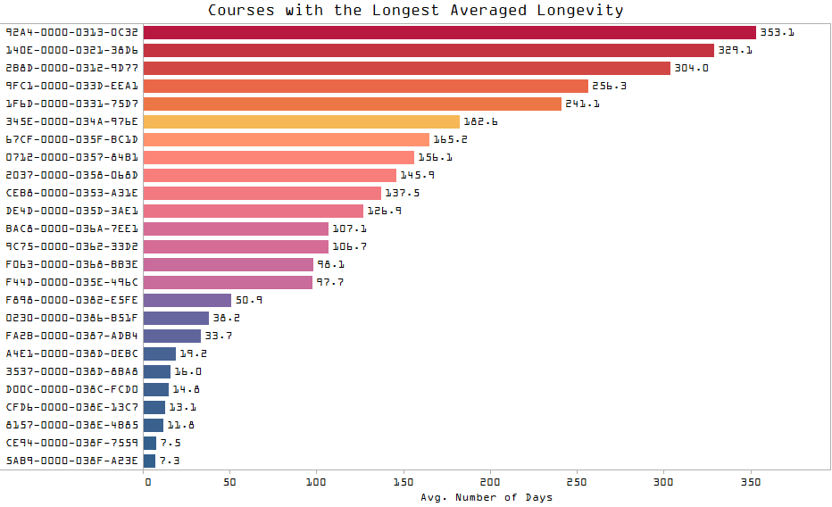

Map ID
Map ID
Notes:
As a sample of the investigation that was conducted, I have provided a chart for the courses with the greatest number of stars and a chart for the courses that that have the longest averaged longevity.
After reviewing each of the criteria, I determined that while there were some courses that were common in all of the criteria, there wasn’t a specific course that could easily be declared as “the most popular”.
This raised the question: how could we determine the most popular courses with the results of this investigation?

Slide 14
What Criteria Should be Used?
Longest Running Map
Number of Attempts
Number of Stars (AKA Likes)
Number of Plays
Number of Clears
Notes:
I decided the next best course of action was to collaborate with a few supervisors from the development team to help determine the most beneficial criteria. After our discussion, it was decided that there are 5 areas that would be the most beneficial was:
Longest running map
Number of attempts
Number of Stars
Number of Plays
Number of clears

Slide 15
What Is the Process to Determine the Most Popular Courses?
Notes:
The next stage of the analysis was to find a process to determine the most popular courses.

Slide 16
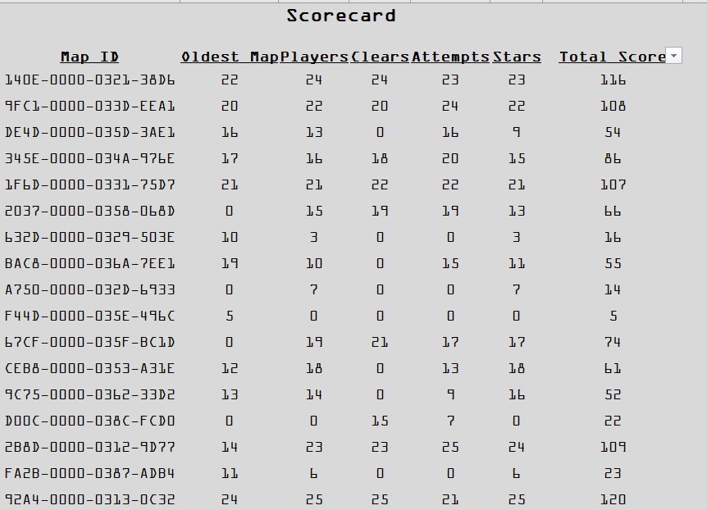
The Process
Clarifications from the Development Team:
Top 15 courses
Equally Weighted Criteria
Determine Top Courses
Apply point value
Find overall highest score
Notes:
During the discussions, we were able to determine that they wanted to know what the top 15 courses currently are. As each of the criteria that was chosen was of equal importance, it was decided that modifications would be made at a future date if warranted.
With this information in mind, the focus was turned to creating a scorecard. The top 25 courses for each criteria was determined and was provided a point value based on where the course ranked within the criteria.
These points were then added together to determine the overall score.

Slide 17

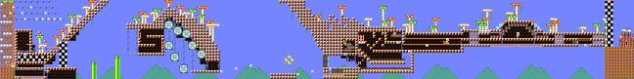

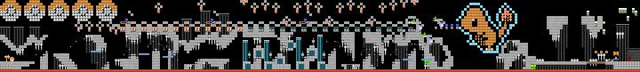
Scorecard Results
Vegas Spring Jump Training Lvl 1
Zelda: Temple of Courage
Just the Tip…of the Iceberg
Mario Kart DELUXE?!?
The Fall of Muncher Manor
Pokemon – VS Champion Red
The Kindly Marked Troll Level
Stoneman 2: Stoneman’s Revenge
LSB: Boot on Boo Boogaloo
Tricky House #1: Spring Time
2YMM Ode to Odyssey
You’ve Learned Nothing! #Contest
2YMM Pipe Connection Issues
Floor is Nada
Halloween 4 Spooky Sacrifices
Notes:
Once the overall score was calculated, the courses were then ranked from largest score to the smallest and the top 15 courses were determined.
Within these courses:
67% of these courses were made with the original Mario Brothers game style
73% were at a level of difficulty of Expert or Super Expert.

Slide 18
Next Steps
Player Behavior
Course Demand Trends After Creation
Level of Difficulty
Popular Course Longevity
Notes:
Based on the results of the analysis, there are a few things that can be explored further.
This data does provide an opportunity to further explore player behavior and the trends in plays after a course is created. However, these types of analysis do require a sufficient amount of memory and it would be recommended to have access to a cloud platform in order to run efficiently.
If additional data with recorded timeframes is provided, we can analyze how the change of level difficulty affects the popularity of the course.
The final recommendation is to determine whether there is higher importance on certain criteria. As mentioned earlier, the analysis can be modified and we can review the result to see how they differ.

Slide 19
Thank You to Our Sponsors
Greater Sacramento Urban League
Greater Sacramento Economic Council
General Assembly
Notes:
At this time, I would like to thank you again for listening

Slide 20
Questions
Notes:
And I open the floor for any questions.

Slide 21
Sources
Dataset:
https://www.kaggle.com/leomauro/smmnet?select=players.csv
Outside Resources:
https://www.nintendo.com/games/detail/super-mario-maker-wii-u/
https://www.nintendoworldreport.com/feature/40570/nintendo-e3-2015-booth-pictures-super-mario-maker
https://metro.co.uk/2016/06/04/super-mario-maker-is-my-game-of-the-generation-readers-feature-5923029/
https://kotaku.com/new-mario-maker-guidelines-still-dont-explain-why-level-1769891036
https://www.vg247.com/2016/05/18/super-mario-maker-is-pretty-damn-popular/
Notes:
If provided access to a cloud platform, a deeper analysis into player behavior and demand trends once a course is created could be performed.
If provided additional recorded timeframes, I could further analyze the change frequencies of level of difficulty and the affect this has on the overall popularity of specific courses.
With more focused parameters for scoring, this analysis can be updated to determine if the most popular courses remain the same.

